Slide 1
Quantum Dots
Nathan Pierce
University of Michigan – Dearborn
Department of Natural Sciences
Determine radii of four differently-sized nanometer scale particles by application of quantum mechanics and by measuring peak wavelengths from their spectra.

Slide 2
Outline
Introduction: What is a quantum dot?
Theory: Quantization of energy & Bulk InP vs. InP in solution
Apparatus & Methods: Transform collected spectra
Results/Discussion
Conclusion

Slide 3
Quantum Dots? Intro
The dot: Semiconductor Nano-particles, Indium Phosphide (InP)
Macroscopic investigation of a quantum system – fluoresced color in visible depends on the size of the particle.
Spectroscopy, quantum & semiconductor physics
Goal: determine the sizes of the quantum dots

Slide 4
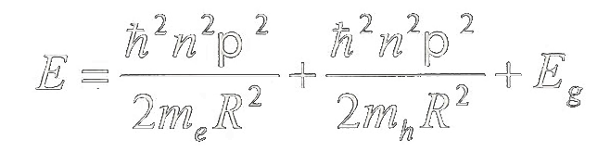

Theory
Bulk InP does not visibly fluoresce, but InP solution does. Why?
$λ_{photon}≈\frac{1240 eV nm}{E_{gap}}$, $E_{gap,bulk}=1.344 eV$, $λ_{photon}≈923 nm$
Bulk InP emits in IR range. What’s the difference? Boundary conditions.
Quantum dot: particles in a box. Physical size of dot $R$ constrains energy of emitted photons
Increasing R reduces emitted photon
Energy! We can measure E – then solve
for R.

Slide 5
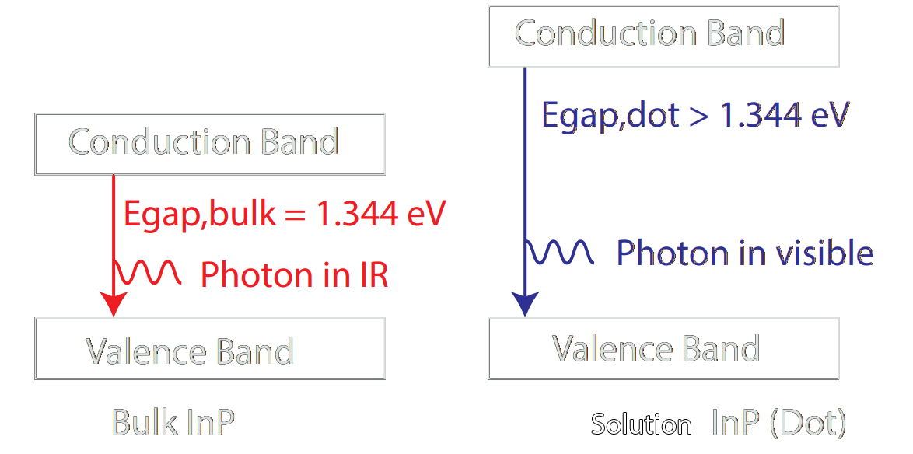

Theory
The InP solution has a larger band gap energy than the bulk InP, by amount $∆E$.
A larger band gap results in an emitted photon of greater energy.

Slide 6
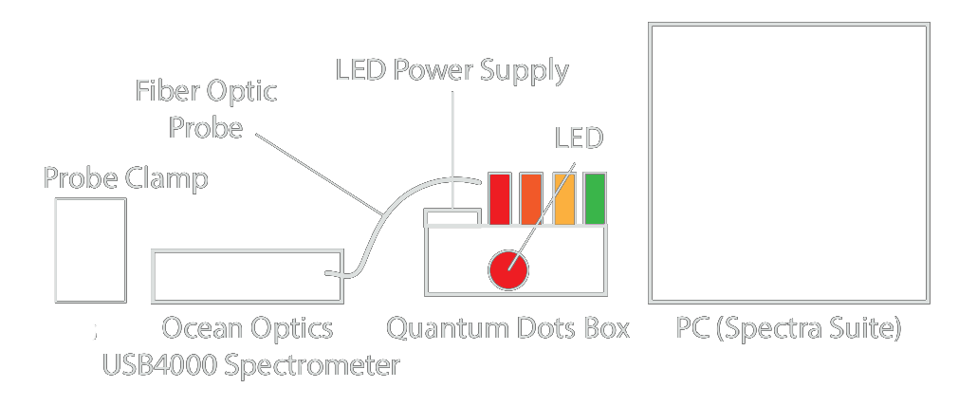
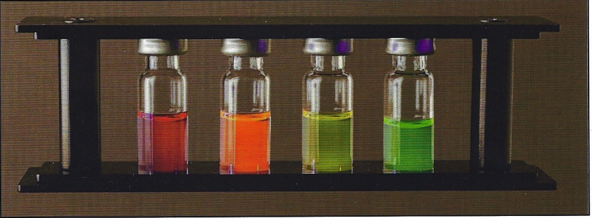
Apparatus
Fig. 1 – Line diagram of experimental setup.
Fig. 2 – Photograph of the quantum dot vials.
Source: CENCO

Slide 7

Methods
Illuminate each vial with $400 nm$ excitation source.
Measure peak emission wavelengths of spectroscopic samples for each quantum dot. Only the peak wavelength matters.
Transform emission wavelength to energy using $E=\frac{hc}{λ}$
Once the energy is known, we solve for R.

Slide 8
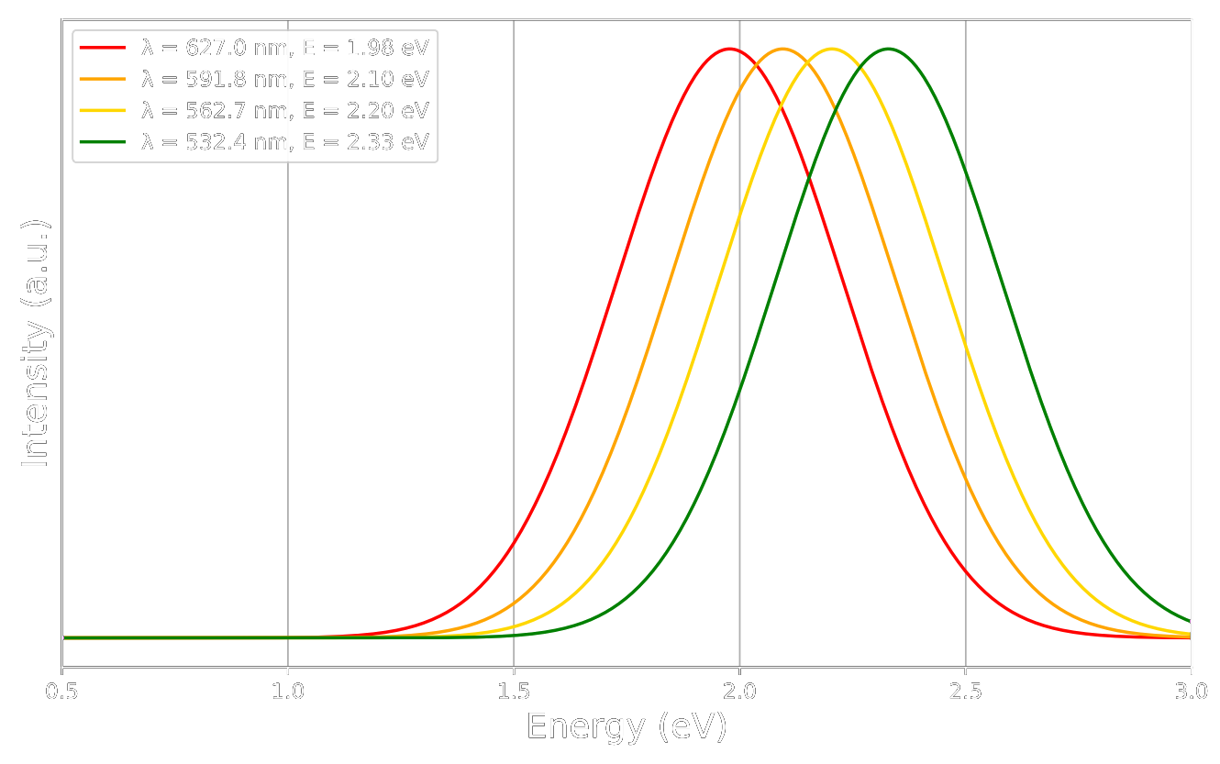

Results
Fig. 3 - Peaks are normalized for easy
comparison of locations. The curves
are generated by a single-peak
Gaussian function.
$$E_{peak}=\frac{hc}{{\text{λ}}_{peak}}$$

Slide 9
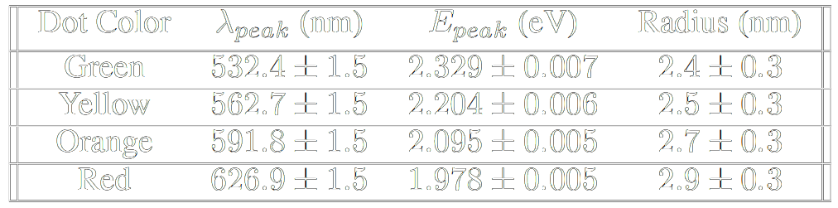
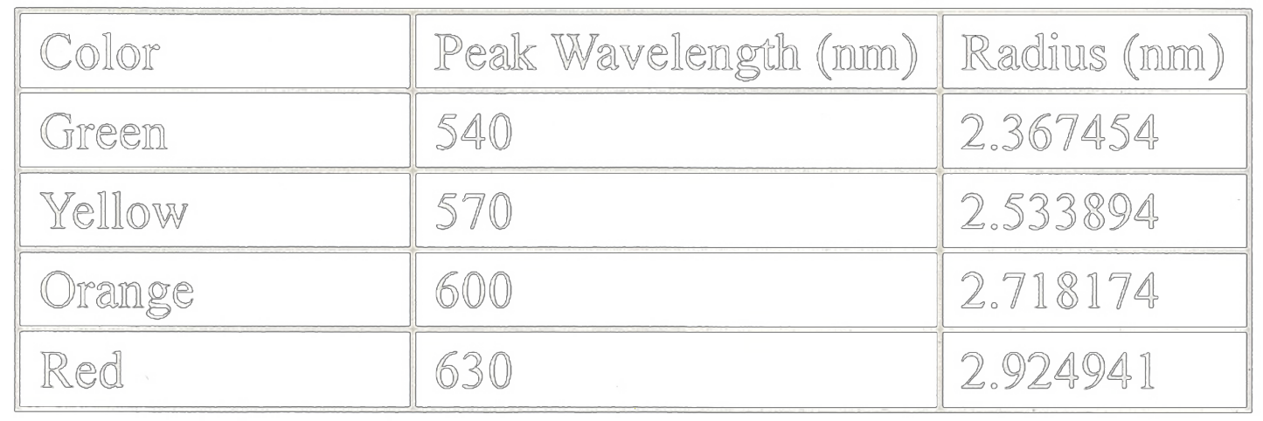
Results
Fig 4 – Experimental results.
Fig 5 – Manufacturer provided values.

Slide 10
Conclusion
Color (λ) of InP solution shown to depend on size of the InP particle. Band gap energy dependence on R observed.
Nano-particle exhibits macroscopic behavior predicted by quantum theory.
Calculated nano-particle sizes in agreement with the manufacturer values.

Slide 11
Sources
Griffiths, David Jeffrey, and Darrell F. Schroeter. Introduction to Quantum Mechanics. Cambridge University Press, 2019.
Modern Physics, by Kenneth S. Krane, 3rd ed., Wiley, 2020, pp. 326–357.
Operating Instructions, 1751-18 CENCO Quantum Dots Lab Manual

